Slide 1


Swap Wear Apparel Platform (SWAP)
Product Owner: Ishaan Das
Scrum Master: Hemal Reddy (Sprint 1)
Frank Nguyen (Sprint 2)
Preethika Rangamgari (Sprint 3)
Justin Lu (Sprint 4)

Slide 2
SWAP
The problem currently is the escalating environmental harm caused by the fast fashion industry. The overconsumption of clothing and lack of efficient recycling options lead to significant textile waste, contributing to environmental degradation. Addressing this issue is crucial for minimizing the ecological footprint of the fashion industry
SWAP aims to be a sustainable solution to combat the environmental damage caused by the fashion industry while also providing a platform for acquiring a fresh wardrobe. It’s targeted for people that are into thrifting new clothes and offering some of their old pieces as well

Slide 3
Project Scope
Login
Following/Followers
Be able to post your products by uploading pictures and a description
Be able to view your curated post feed based on your interests
Be able to view recommendations of people to follow based on your interests
Be able to send/decline swap offers

Slide 4
Sprint 1
User stories:
As a user, I want to login/sign-up for the web-app so that I have a personalized account
As a user, I want to post my products so that people can see what I have to offer
Spikes:
Learning MongoDB data modeling, transactions, and interface, design patterns, REST endpoints from client to server, Jira
Infrastructure tasks:
Setting up git repo, development environments, initial Spring and React projects, MongoDB database connection, Jira

Slide 5
Sprint 2
User stories:
As a user, I want to send and accept/decline offers from others so that other users can know what I’m interested in and I can see what others are interested in what I have to offer
As a user, I want to search for products using keywords and filters so that I can look for specific posts that I might be interested in
As a user, I want to view my recommended feed so that I can have a curated feed for me based upon my interests
Spikes:
Learning about notifications for user after sending/accepting offers
Learning advanced querying in MongoDB for the searching products
Familiarizing ourselves with the MongoDB Atlas interface
Learning about eager fetching from database to load posts for recommended page
Infrastructure Tasks:
Setting up postman endpoints for testing

Slide 6
Sprint 3
User stories:
As a user, I want to be able to follow others and view who follows me so that I can feel the social media aspects of the application
As a user, I want to be able to view my profile of posted products so that I can see if there are any posts that I want to delete or change
Spikes:
Explore different data models and database structures for efficiently managing user relationships
Investigate messaging system options, such as real-time messaging or asynchronous messaging
Infrastructure tasks:
Consider scalability as the number of users and relationships grows.

Slide 7
Sprint 4
User stories:
As a user, I want to be able to scan a QR code to view each user's personal page so that I can easily share my profile
As a user, I want to message other users to communicate with them about details about offers or specifics
Spikes:
Explore messaging service options, such as WebSocket, third-party APIs (e.g., Twilio), or in-app messaging libraries.
Investigate how to implement real-time notifications for new messages and updates to user profiles or product posts
Look into AWS Lambda for web app deployment
Infrastructure tasks:
Setup QR code generation libraries or APIs
Learning Socket.IO for integrating messaging libraries

Slide 8
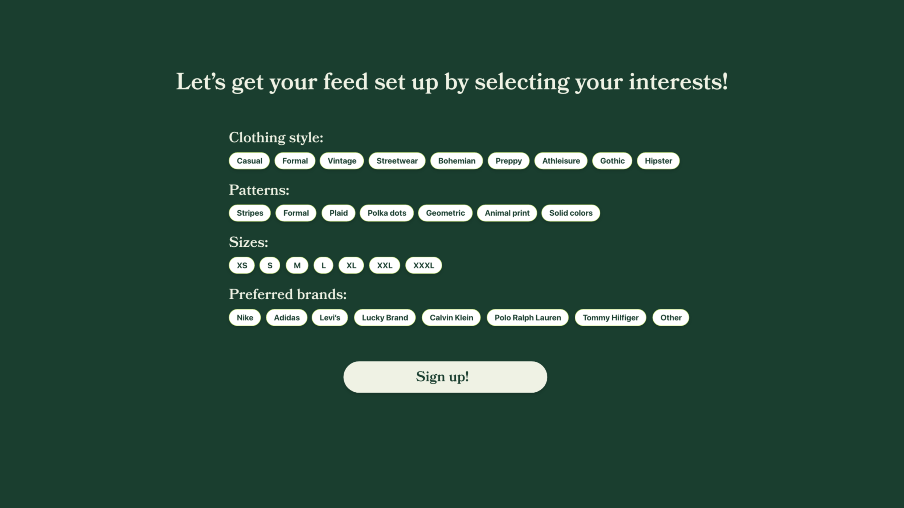
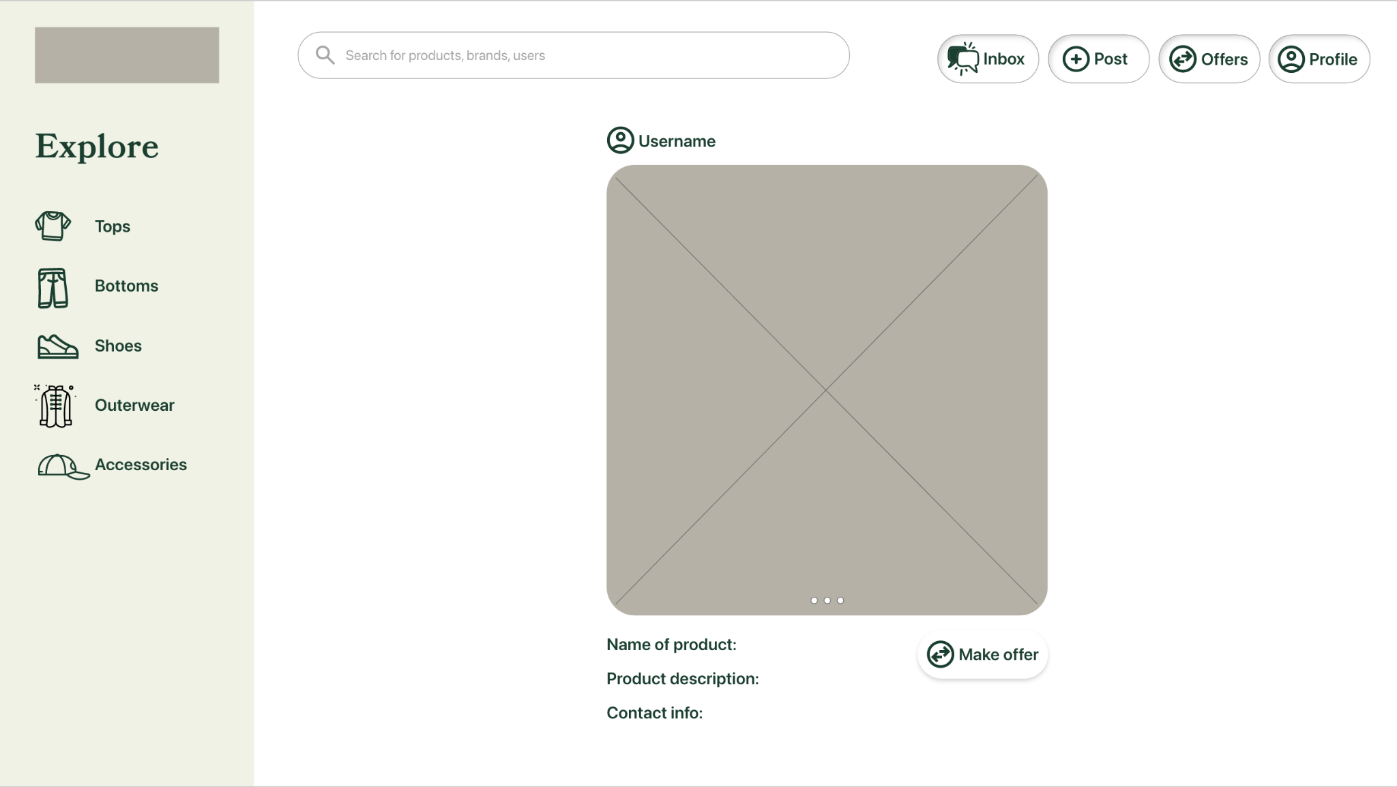
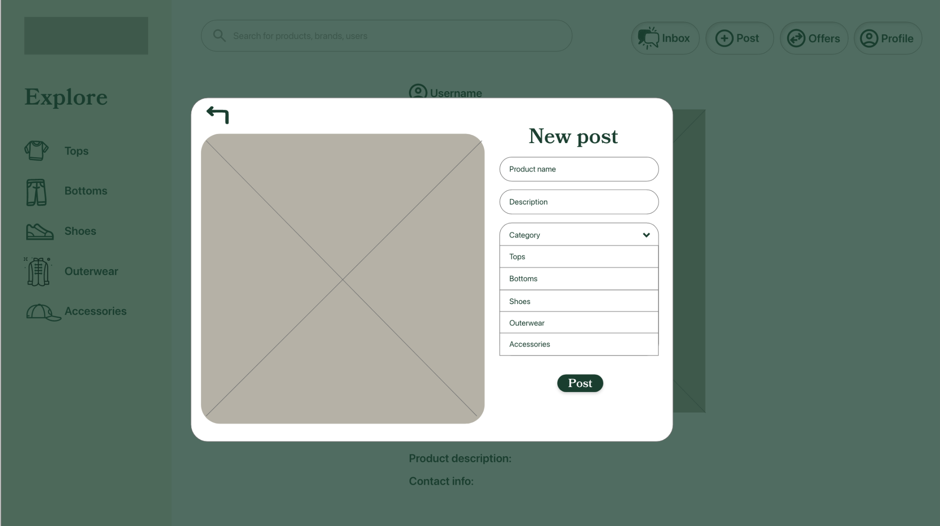
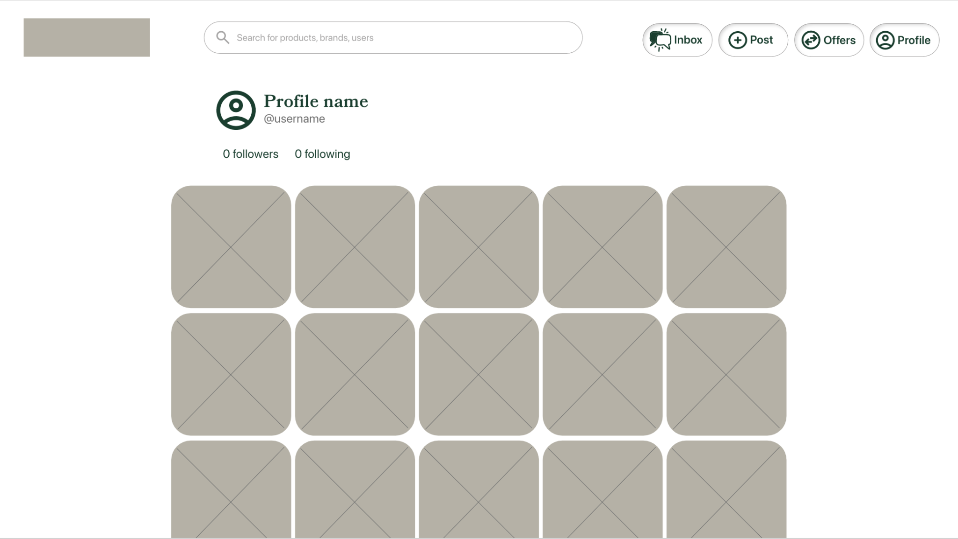
Architecture

Slide 9
Technologies
React JS for Frontend Development
Spring Boot and Java for Backend Development
MongoDB Atlas for the database hosting
Adobe Xd for designing User Interface
Jira for project management
AWS Lambda for deployment

Slide 10
Challenges/Risks
Setting up MongoDB clusters
Enough storage for images in Mongo Documents
Unfamiliar technology for loading posts in UI
Unfamiliar technology for notifications
Jira is unfamiliar technology
Learning to work with AWS Lambda interface

Slide 11
Minimum Viable Product (MVP)
Users should be able to:
Create an account
Post pictures of their clothes
See other people’s posts
Offer/Accept/Decline swaps
Stretch:
Notifications for new messages, and offers.

